Slide 1


Interpretation
Basics
For Pro Bono
Law Firm
Interpreters

Slide 2
Welcome & Purpose
For law firm personnel with little or no formal training on interpreting in pro bono matters
Providing an overview on interpretation basics for people who may be new to it
The start of a learning journey, not the end!
Thank you for interpreting on a pro bono case!

Slide 3
Who we are
Joann Lee, LAFLA
Maria Kutnick, Winston
Eddy Rivas, Skadden
Alejandra Oliva, Author

Slide 4
Agenda
Introduction. Language justice basics & pro bono language access principles
Interpretation basics. Tips on how to interpret effectively
Working with the team. Strategies for collaborating with attorneys and clients
Self care. Boundaries & taking care of yourself
Next steps. Links to additional resources

Slide 5
I. Introduction
Language justice basics & pro bono language ACCESS principles

Slide 6
Law Firm Pro Bono Language Access Principles
This training is offered by a coalition of pro bono professionals at law firms and legal aid organizations
Law Firm Pro Bono Language Access Principles:
  Equal access to pro bono. No prospective client should be turned away because of language.
  Law firm responsibility. Law firms are responsible for securing interpretation on pro bono matters without cost or burden to clients or legal aid organizations.
  Quality. Interpretation should meet basic standards and not be done by friends or family, although it need not be done by professional interpreters.

Slide 7
LANGUAGE JUSTICE
Language justice is based in respect for the language rights of all people, including people whose languages have been exiled, disappeared, stolen or made invisible through processes of colonial violence. Language justice is a political foundation, a conceptual framework, and a set of tools and practices we can use in organizing and artmaking, in our civic life, our interpersonal relationships, our learning spaces, and our imagining and embodying of the world we wish to inhabit.
-ANTENA AIRE

Slide 8

Language Justice includes…
the right of all people to communicate, to understand and to be understood in our language(s);
creating spaces where everyone can fully participate and no one language dominates over others;
a commitment to equitable communication;
respect for everyone’s language rights.

Slide 9
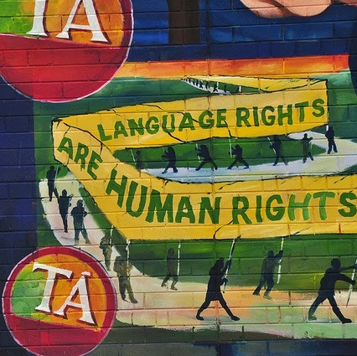
Language Rights
The right:
to be free from discrimination based on language
to have meaningful access to public services and civic participation (often via interpreting, translation, and multilingual staff)
to maintain non-dominant languages and pass them on to future generations
for everyone’s languages to be valued and respected

Slide 10
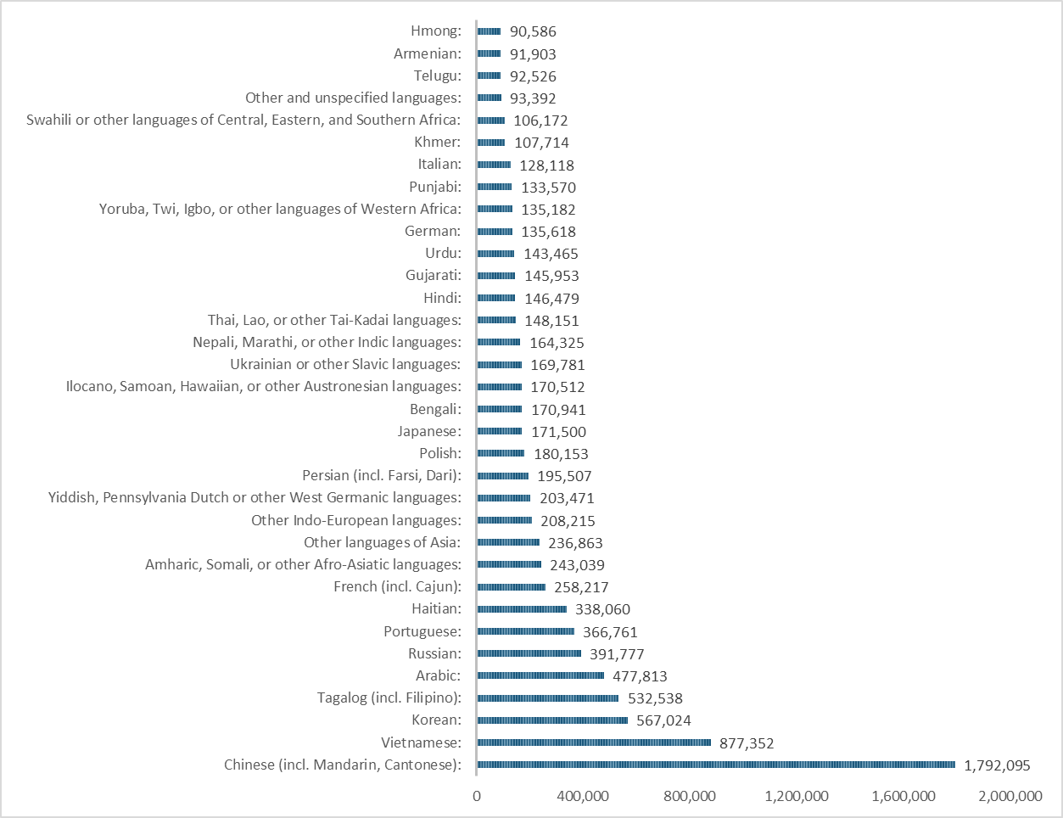
Top Language Groups with Limited English Proficiency (ACS)
United States (2022)
Over 69 million speak language other than English
Total population with LEP: 26.5 million
Largest language group with LEP is Spanish at 16,757,866 (63% of total LEP)

Slide 11
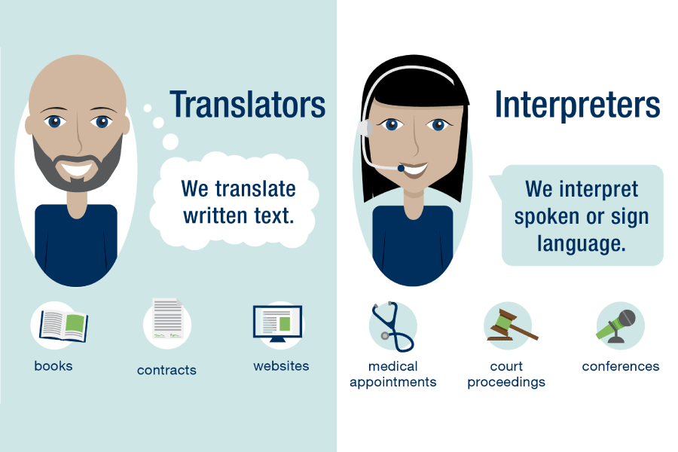
Basic Terminology
Image: American Translators Association: www.atanet.org

Slide 12
The Role of the Interpreter
The role of interpreters is to use spoken or signed language to transmit a message from one language into another without adding, deleting, or changing the meaning, tone, or register of the message.
The purpose of interpreting is to facilitate direct communication between people who do not share a common language.
Who is the interpreter there for? Everyone.

Slide 13
II. Key Tips on Effective Interpretation

Slide 14
Interpreters Need Specialized Skills & Knowledge
SKILLS
Advanced proficiency in two or more languages
Rapid mental processing
Strong memory retention
Strong concentration
High attention to detail
Note taking skills
Listening-talking simultaneity skills (split-focus)
Public speaking skills
KNOWLEDGE
Codes of Ethics
Standard interpreting techniques, e.g., first person
Specialized vocabulary
Broad basic knowledge of content area(s)
Technology: Interpreting equipment and remote platforms
Laws, policies, and rules affecting interpreting

Slide 15

Confidentiality
Interpreter must maintain confidentiality at all times
Competency
Interpreter must express concerns about ability or capacity to support full and open communication, e.g., not being a language match
Accuracy
Interpreter must interpret everything that is said, accurately and completely, including preserving the register and tone to the best of one’s ability
Impartiality
Interpreter must be neutral // not have a stake in the outcome for either side // no actual or perceived conflicts of interest
Key Tenets of Interpreter Ethics

Slide 16
Best Practices for Interpreters
Request materials in advance for preparation when possible; at a minimum, ask for a brief summary of the context.
Do a language & variant check before or at the beginning of the session.
Before you start, the interpreter or attorney should review guidelines/pre-session.
Take notes and have writing utensils or devices ready.
Use direct 1st person speech. Don’t say to the attorney or client, “the client said …” or "the attorney wants you to …." Interpreters should always use 1st person.
Remind everyone to speak clearly at a moderate pace, pausing every 2-3 sentences to wait for interpreting. Help facilitate turn taking and use gestures, if needed.
Encourage direct communication between client and attorney. Try to avoid direct eye contact with either party.
Avoid side conversations with either party.
Long session? Schedule breaks or request a partner.
Consider a post-session debrief if there were issues or concerns that arose during the session.

Slide 17
Best Practices for Document Translation
Be cautious about machine translation/AI + learn your firm’s policy on AI
Adapt the document to plain language before translation
Use icons and images that will resonate
Leave extra space; some translations are 1.25-1.5 times longer
Decide on format, e.g., content in each language side-by-side, separate documents, etc.
Docs with special formatting or design may require additional steps/time
Not possible to translate a doc?
  A qualified interpreter can provide a sight translation.
  The document can be explained in plain language and a qualified interpreter can consecutively interpret.
  Consider other methods to convey information in-language, such as social media platforms and ethnic press outlets.

Slide 18
Best Practices for Interpreting Traumatic Events
Remember to stay calm, empathetic and non-judgmental
  This includes your body language! Be aware of things like crossed arms, facial expressions and more
You may have to interrupt your client if they are not pausing to allow you to interpret.
  This is not going to feel good, but it is more important to be able to accurately interpret all their words!
Respond to the client like a human before you do so as an interpreter
Take breaks as need be—check in with the client, but don't be afraid to ask for breaks for yourself either!

Slide 19
Interpretation & Identity
Language is powerful, and sometimes can be damaging
Know the client’s pronouns (ask if you aren’t sure) and think through how you will handle gendered language
Words related to identity are highly subjective and the client may have a strong preference for particular terminology.
Always give the client the power to use the language they prefer – ask them when you aren’t sure, and then follow their lead!

Slide 20
III. Working with The rest of the team

Slide 21
You Matter & Your Work as an Interpreter is Crucial to the Case!
No legal work can be done without you serving as an interpreter
Your work product (as an interpreter) is every bit as important as the work that the attorneys do
Your relationship with the team and the client is important
That means you will need the tools and preparation to do your best work.

Slide 22
Talk to the Team
Have a conversation with the attorneys on the case before you get started
01
Explain what you will need in advance to properly prepare
02
Discuss interpretation basics for how the session will go
03
Learn what your role will be on the case going forward
04

Slide 23
Before you Interpret
An overview of the case and the subject of the session you will be interpreting for
Access to any relevant legal training that the attorneys attended for the case
Advance access to key documents
Flagging of key legal terms that may come up
Identify sensitive language issues that may come up around trauma, bias, identity, and beyond.
Schedule a time to meet with the attorneys prior to the interview to go over expectations and roles.

Slide 24


During the Session
    The role of the interpreter is to repeat everything said in the other language as accurately as possible. Interpreters can’t answer questions or provide opinions.
    The interpreter will maintain confidentiality about everything that is discussed.
    People should speak clearly at a moderate pace.
    Each party should say 2-3 sentences at a time and then wait for the interpreter to transmit the message. The interpreter should signal if they need a pause or clarification. Each party should wait for the interpreter to finish speaking before continuing the conversation.
    Don’t interrupt or speak at the same time as anyone else.
    The parties should be encouraged and positioned to look and speak directly to each other, not to the interpreter.

Slide 25
Introduction to the client
"Hello my name is Juana Perez, and I'll be interpreting for you between English and Spanish. I work with your attorney in the finance department, so I'm not a lawyer myself."
  Name, languages, and professional affiliation/clarify your role
"During this session, please speak directly to the attorney, and I'll interpret everything you say as you say it."
  Set up norms for the conversation and clearly define your role
"It's helpful to me if you speak in short sentences and pause often so I have time to understand and interpret. If I need you to pause, I'll raise my hand."
  Explain your own needs, and especially how this might be different from a regular conversation
"Everything I hear or say in this meeting will be confidential, just like with your attorney."
  Ethics and confidentiality reminder
"Can you understand me ok? Do you have any questions?"
  Language and content comprehension check.

Slide 26
During the Session
ESTABLISH TRUST
Being non-judgmental, getting details right, and being communicative can help you establish trust with your client.
EXPLAIN YOUR PROCESS
Tell your client clearly at the beginning of the session what you need, and explain that you may need to interrupt if they speak for too long
TAKE BREAKS
Let the client know they can ask for that, or advocate for a break yourself
BE HUMAN
Respond to your client like a human, even if it falls outside the bounds of the usual interpreter relationship

Slide 27
DURING
THE SESSION
DURING BREAKS
Focus on your body and its needs. Do breathing exercises, drink some water, eat a snack, take a walk, get some fresh air, or stretch to ground yourself.
TAP OUT IF YOU NEED TO
If you realize you're having a hard time, or not able to continue your session, excuse yourself as calmly as you can and reach out to the client ASAP with additional resources
IF YOU DRAW A BLANK-DON'T PANIC!

Slide 28
EXPANSION
CONTRACTION
"Furniture"
"Chairs, tables, dressers"
"Chairs, tables, dressers"
"Furniture"
INTERJECTION
FILL
IN
THE
BLANKS
"I'm not sure what that means, can you phrase it a different way?"
"Table"
"The furniture you sit around to eat"
"Queen bee"
"Mother bee"
DEFINITION
QUICK DECISION

Slide 29
AFTER THE SESSION
Need to schedule new session?
Do they need to bring documents?
Logistical issues wrapped up, etc.

Slide 30
Troubleshooting Common Issues – What if . . .
you do not share the same language or linguistic variant as the client.
you do not have the legal vocabulary to communicate effectively.
the session is too long, and you are losing focus.
the attorney uses the third person to tell you what to say to the client ("tell her to send me the documents").
the client continues to direct questions and comments directly to you (the interpreter) and not the attorney.
Notes:
Maybe this could be interactive?

Slide 31

Troubleshooting - in action (training video)
Working with Interpreters Overview Video
Legal Aid Foundation of Los Angeles
https://www.youtube.com/watch?v=8ofKgOYg0vI&t=1s
Notes:
5:38 – 8:35 (we should try to clip this? I don't think we can do it in PPT but it is possible in Slides).
Or if a shorter clip is better, we could do 5:38 – 6:50.

Slide 32
IV. Self Care

Slide 33
Interpreting is Intense!
It's intense in a lot of different ways!
  Mentally
  Emotionally
  Socially
You may also experience vicarious trauma

Slide 34
HOW DOES TRAUMA SHOW UP IN LANGUAGE WORKERS?
Vicarious trauma is the emotional response experienced by people (often in helping professions, including translators and interpreters) who witness the suffering of others

Slide 35
Hearing client's difficult stories and traumatic experiences
HOW DOES TRAUMA SHOW UP IN LANGUAGE WORKERS?
Shared cultural or individual histories with our clients
Accompanying clients as they engage with harmful institutions
Reframing client's stories in the first person

Slide 36
EMOTIONALLY
PHYSICALLY
HOW DOES TRAUMA SHOW UP?
COGNITIVELY
BEHAVIORALLY

Slide 37
EMOTIONALLY
PHYSICALLY
  anxiety
  detachment
  numbness
  sadness
  anger
  overwhelm
  stomachache/nausea
  clamminess/shivering/sweating
  fatigue
  racing thoughts
  difficulty concentrating
  memory problems
  startled reaction
  either a very flat or a very emotional affect
  difficulty expressing yourself
  withdrawal
COGNITIVELY
BEHAVIORALLY

Slide 38
EMOTIONALLY
PHYSICALLY
  anxiety
  detachment
  numbness
  sadness
  anger
  overwhelm
  irritability/hostility
  depression
  mood swings
  anxiety
  grief
  shame
  stomachache/nausea
  clamminess/shivering/sweating
  fatigue
  sleep disturbances/nightmares
  appetite changes
  lowered immune system
  racing thoughts
  difficulty concentrating
  memory problems
  startled reaction
  either a very emotional or a very flat affect
  difficulty expressing yourself
  withdrawal
  flashbacks
  thinking about the event too much or not at all
  generalization of triggers
  relationship disturbances
  high risk behaviors
COGNITIVELY
BEHAVIORALLY

Slide 39
AFTER
THE SESSION
MAKE AN IMMEDIATE SELF-CARE PLAN
Listen to your body and follow up on that: give yourself time to recover from the cognitive and emotional work of interpreting!
MAKE A LONG-TERM SELF-CARE PLAN
Check in with yourself regularly about the work, and find someone to debrief with confidentially—consider beginning an interpreters' support group or Slack channel to connect with other volunteers in the office
FIND JOY AND CONNECTION IN THE WORK
Find ways to make the work sustainable by looking for joy within it

Slide 40
VI. NEXT STEPS

Slide 41
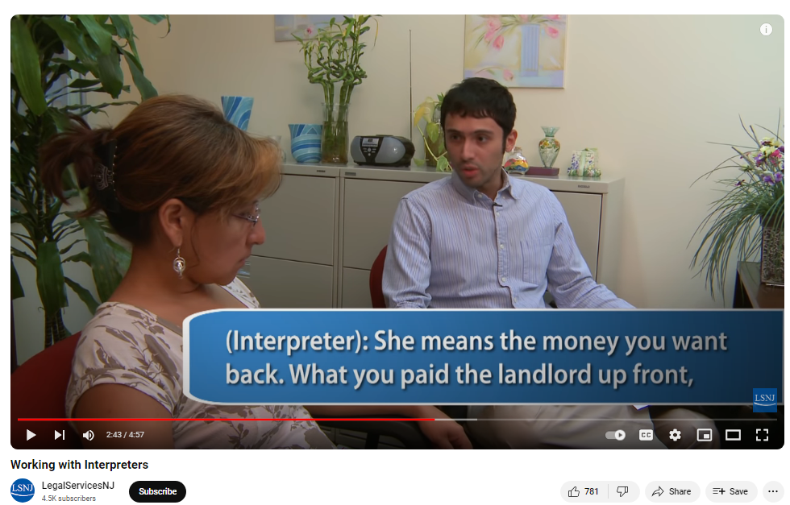
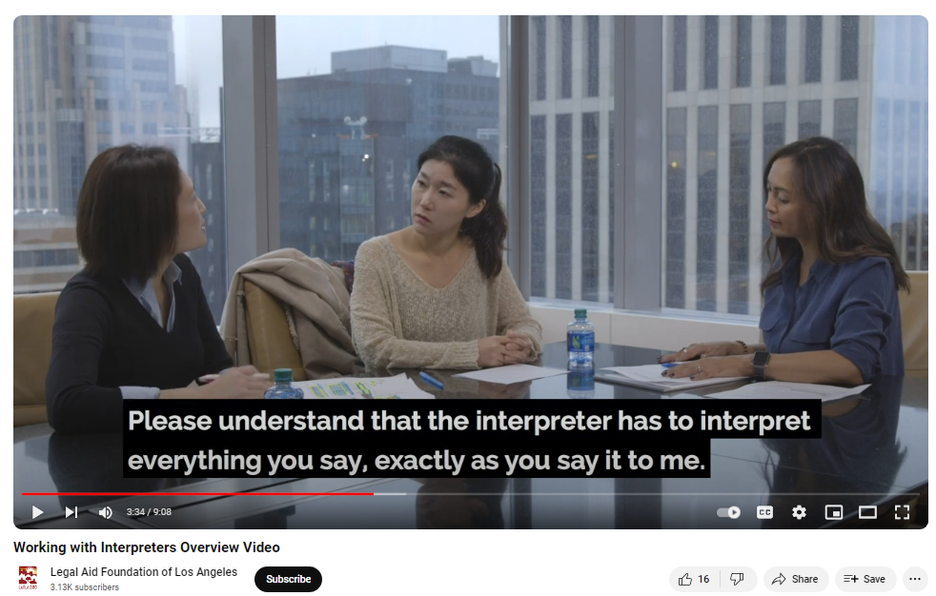
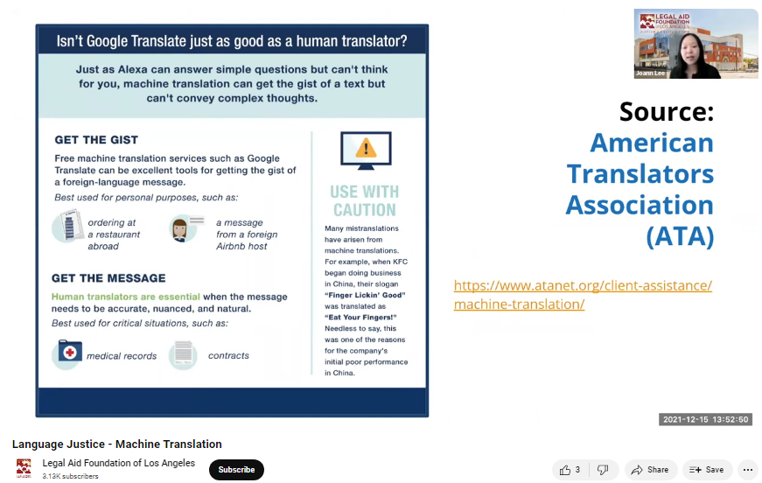
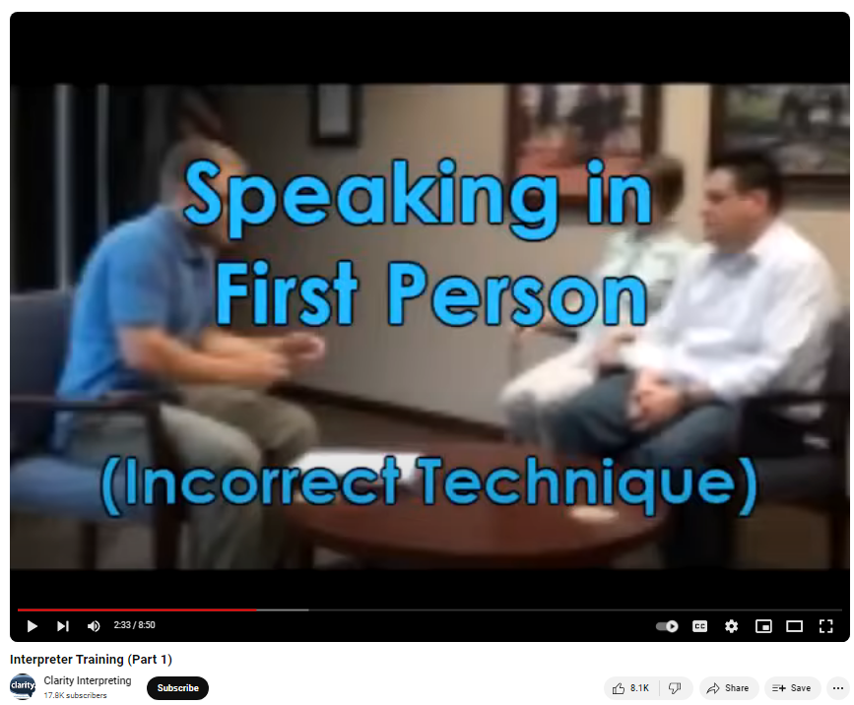
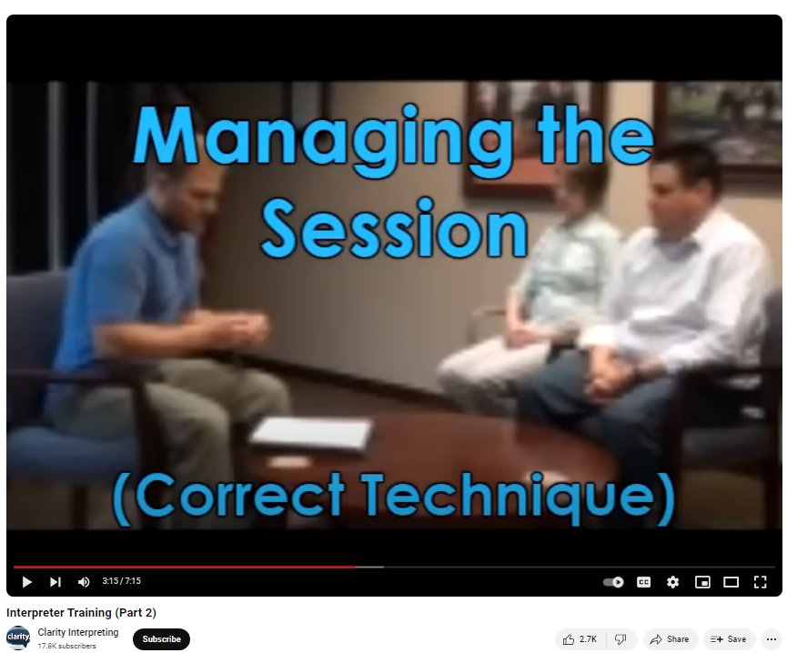
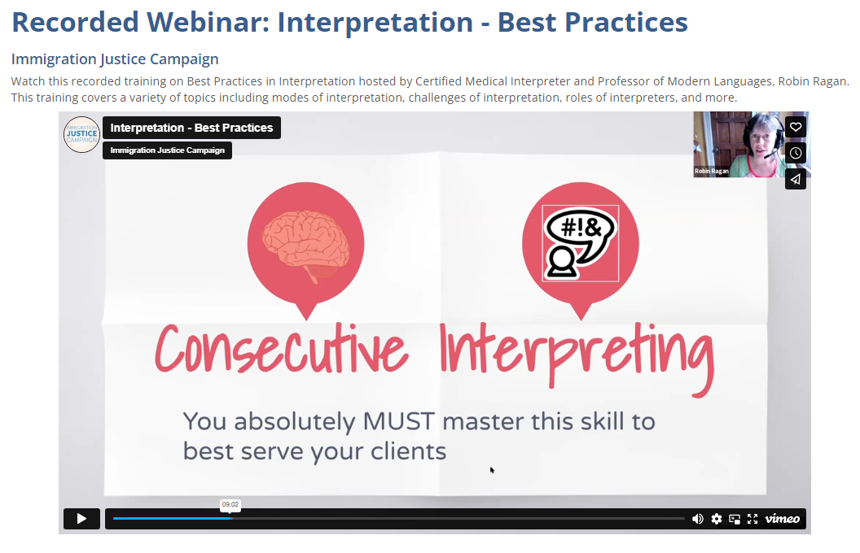
Training Videos
LAFLA - Machine Translation: Is It Really Here . . . or Not?
https://www.youtube.com/watch?v=yPY3V14KCPk
Legal Services of New Jersey – Working with Interpreters
https://www.youtube.com/watch?v=pVm27HLLiiQ
LAFLA – Communicating with Limited English Proficient Clients
https://www.youtube.com/watch?v=8ofKgOYg0vI
Interpreter Training (Part 1) - https://youtu.be/3wg-qZjMhU4
Interpreter Training (Part 2) - https://youtu.be/9e_nIDJV-Lk
Recorded Webinar - https://immigrationjustice.us/get-trained/interpretation-and-translation/interpretation-best-practices/

Slide 42
Training Resources
AYUDA, Breaking Silence, Interpreting for Victim Services
https://ayuda.com/wp-content/uploads/2017/06/Breaking-Silence-Training-Manual-1.pdf
Considerations when Using Interpreters for Victims with Limited English Proficiency, API-GBV: https://www.api-gbv.org/resources/limited-english-proficiency/
Ayuda, Working with Interpreters Outside of the Courtroom: A Guide for Attorneys https://ayuda.com/wp-content/uploads/2017/06/Working_With_Interpreters_2016.pdf
Language Justice Resources: https://langjust.com/resources
More resources here: https://drive.google.com/drive/folders/14ts3H4-j27-6dl7I7zJK6iWmWY7rPJKx?usp=sharing

