Slide 1
Exploring and Understanding Cultural Competency
Samantha Howell, Esq.
Director of Pro Bono & Outreach
Kelly Anderson, Esq.
Senior Immigration Attorney
Prisoners’ Legal Services of New York

Slide 2
What is Cultural Competency?
To be free is not merely to cast off one’s chains, but to live in a way that respects and enhances the freedom of others.
- Nelson Mandela -
Notes:
Many definitions but they generally boil down to this: Cultural competence is having an awareness of one’s own cultural identity and views about difference, and the ability to learn and build on the varying cultural and community norms of students and their families. It is the ability to understand the within-group differences that make each person unique, while celebrating the between-group variations that make our country a tapestry. (National Education Association and National Center for Cultural Competence)
Everyone has a cultural, ethnic, and/or racial identity that shapes their understanding of the world, and perceptions about others.

Slide 3
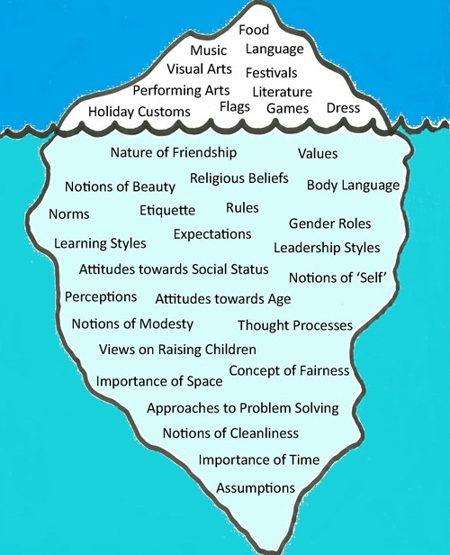
EXPLICIT CULTURE
Behaviors, Attitudes and Beliefs
Implicit Culture
Values
Creative Commons License, The Iceberg Model of Culture, interculturalism.blogspot.ca/2011/03/iceberg-model-of-culture.html, 3/6/11.
Notes:
Like an iceberg, only a small fraction of one’s culture is visible – it is manifested through customs, language, physical appearance, and the events one enjoys. The majority of one’s culture, however, is hidden, visible only through knowledge of the person and his/her background.

Slide 4
Areas of Cultural Competency
Ethnicity
Age
Gender
Mental Health/Illness
Race
Economic
Religion
Language
Sex
Disabilities
Life Experiences
LGBTQIA
Geographic Differences

Slide 5
ACTIVITY #1: Cultures to Which I Belong
Name of Culture | Shared Practices and Beliefs
Notes:
Spend 5 minutes on your list and then 10 minutes with the person next to you, learning about each others cultures.
Report back some of the things that you learned from your neighbors.

Slide 6
Why Is This Important?
Notes:
Antidotes about cultural misunderstandings
Common Mistakes in Working with Diverse Populations:
Interrupting interviews because you believe that they person is done speaking when they were just trying to collect their thoughts
Viewing a given behavior or statement as evidence of a problem (pathological) when it actually is just an example of a cultural difference; alternatively, believing that a behavior is cultural, when it is the result of individual or systemic factors
Using a word/phrase in English or another language in a way that inadvertently offends the person you’re interviewing (or, alternatively, that has no meaning in his/her native language, and you do not explain its meaning)
Thinking you understand what your client is saying and acting on that belief, which turns out to be erroneous
Failing to accommodate the client’s culture in ways that damage rapport (schedule court dates, etc., on a holiday)
Touching people whom you should not touch because of differing cultural beliefs about what such touching means

Slide 7
NY Rules of Professional Conduct
Rule 1.1 – Competence
Rule 1.4 – Communication
Rule 1.6 – Confidentiality of Information
Rule 1.14 – Client with Diminished Capacity
Rule 2.1 – Advisor

Slide 8
ABA Standards for Civil Pro Bono Programs
Standard 2.1 – Infrastructure – Program Personnel
Standard 2.2 – Attorney Supervision of Non-Attorney Staff
Standard 2.6 – Program Effectiveness – Relations with Others
Standard 2.8 – Program Effectiveness – Identification of Client’s Needs
Standard 2.9 – Service Delivery Systems – Program Priorities
Standard 2.11 – Service Delivery Design – Client Community Access
Standard 3.1 – The Initial Contact – Establishment of an Effective Relationship
Standard 3.2 – The Initial Contact – Communication with Clients
Standard 3.5 – Establishing the Relationship – Non-Discrimination and Diversity
Standard 4.2 – The Initial Interaction – Non-Discrimination and Diversity
Standard 4.4. – Building a Strong Relationship with Volunteers
http://www.americanbar.org/content/dam/aba/images/news/PDF/109.pdf
Notes:
Adopted in 2013

Slide 9
Working with Diverse Client Populations
Requires …
    The Utilization of Different Approaches Based on Type of Communication in Use
    Active Listening Skills
    Redirection
Notes:
Different Approaches Based on Communication:
Restating what the client said to ensure understanding
Drawing a diagram of the process
Discussing timeframes carefully (non-linear understanding)
Active Listening Skills
Listening to client and asking questions to ensure comprehensive understanding
Inquire about phrases/words or mannerisms that are unfamiliar
Don’t just wait for your time to explain/talk
Redirection
Help client focus on issue(s)
Redirect conversations respectfully and acknowledge the importance of what the client is saying

Slide 10
ACTIVITY #2: Four Stages of Cultural Competence
Stage 1: Unconscious Incompetence | Stage 2: Conscious Incompetence
Stage 3: Conscious Competence | Stage 4: Unconscious Competence
Notes:
Stage 1 – Unconscious Incompetence – You are unaware of the skill and your lack of proficiency
Stage 2 – Conscious Incompetence – You are aware of the skill but not yet proficient
Stage 3 – Conscious Competence – You are able to use the skill, but only with effort
Stage 4 – Unconscious Competence – Performing the skill becomes automatic
Exercise – You are meeting with a new client, Jose Arachavaleta, who has questions about accessing public benefits and his pending criminal case for drug possession. He moved to the U.S. from Nicaragua and speaks the local dialect fluently, and English with limited proficiency. Let’s move through the 4 stages of cultural competence together!
Stage 1 – How would you greet him? What questions might you ask at your first appointment?
Stage 2 –
Stage 3 –
Stage 4 – How do you greet his cousin, who comes to see you three months later?

Slide 11
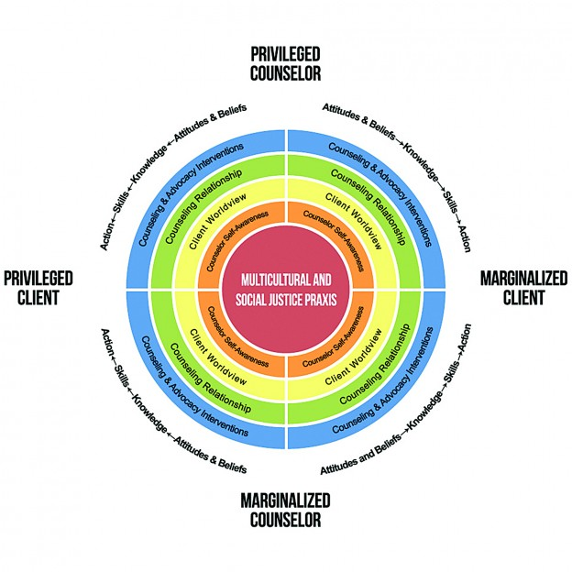
Cultural Competency in Our Work
Notes:
https://www.counseling.org/docs/default-source/competencies/multicultural-and-social-justice-counseling-competencies.pdf?sfvrsn=20
Counselors must develop a self-awareness of their own attitudes, beliefs and biases

Slide 12
Cultural Competency in Our Work
Integrate Multicultural and Social Justice Counseling Competencies (MSJCC)
  Developmental Domains:
    Counselor Self-Awareness
    Client Worldview
    Counseling Relationship
    Counseling and Advocacy Interventions
  Developed by The Multicultural Counseling Competencies Revision Committee, Endorsed by the American Counseling Association Governing Council on July 20, 2015.
Notes:
Targeted toward counselors but relevant to attorneys and advocates
Counselor Self-Awareness – Strive to develop self-awareness, so that you may explore attitudes/beliefs, develop knowledge, skills, and action relative to self-awareness and worldview
Client Worldview – Aware, knowledgeable, skilled, and action-oriented in understanding clients’ worldviews
Counseling Relationship – Aware, knowledgeable, skilled and action-oriented in understanding how the marginalized or privileged statuses of the client and attorney influences the relationship
Counseling and Advocacy Interventions – Intervene with, and on behalf of, clients at the intrapersonal, interpersonal, institutional, community, public policy, and international/global levels.
Let’s go back to Jose. How can we increase our understanding of Jose’s legal needs, utilizing these skills?

Slide 13
Vicarious Trauma
AKA Compassion Fatigue, can result from:
    Working with clients in crisis
    Dealing with the client’s past trauma (immigration, DV, etc.)
    Responding to and respecting crisis/trauma experienced by co-workers
  https://www.counseling.org/docs/trauma-disaster/fact-sheet-9---vicarious-trauma.pdf?sfvrsn=2
Notes:
The American Counseling Association defines it as “the emotional residue of exposure that counselors have from working with people as they are hearing their trauma stories and become witnesses to the pain, fear and terror that trauma survivors have endured.” Different from burnout, which can be improved by change in job or time off
Tips:
Monitor yourself.
Take care of yourself.
Take time for yourself.
Separate yourself.
Limit yourself.
Help yourself.
Be honest with yourself.
Empower yourself.

Slide 14
ACTIVITY #3: Scavenger Hunt
Notes:
Handout form and have people spend about 10 minutes seeking out as many “gets” as they can

Slide 15
Take-Aways
Importance of Understanding Personal Biases/Perspectives
Appreciation for Your Client’s Story
Role of Cultural Competency in the Law
Learn how to best represent your clients with compassion and empathy

